Slide 1
Matrix Factorization Techniques For Recommender Systems
Yehuda Koren, Robert Bell, Chris Volinsky
2009 IEEE Computer Society

Slide 2
Recommender System Strategies
Retailers interest in recommender systems, e.g. Amazon, Netflix
Based on one of two strategies or hybrid:
Content filtering
Create a profile for each user or product to characterize.
Require external information .
Collaborative filtering
Analyzes relationships between users and products to find new user-item associations.
Rely only on past user behavior.

Slide 3
Collaborative filtering
Neighborhood methods:
Center on computing the relationships between items or between users.
Item-oriented approach
A product and its neighbors get similar rating by same user.
User-oriented approach
Identifies like-minded user who can complement each other’s ratings.

Slide 4
Collaborative filtering
Latent factor models:
Explain the rating by characterizing both items and users on 20 – 100 factors inferred from the ratings patterns.
These factors are in general not obvious
Hard to estimate their impact on the ratings.
For user, each factor measures how much the user likes movies that corresponding movie factors.
The goal :to deduct the factors by using mathematical techniques.

Slide 5
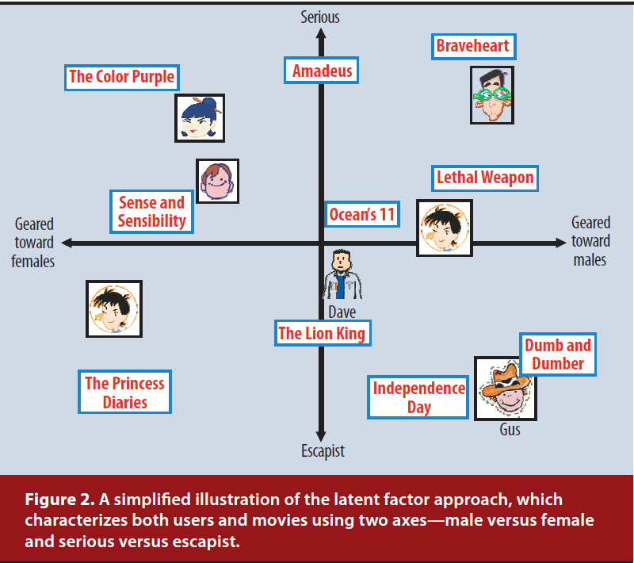

Slide 6
Some Problems Need to be solved
Data sparsity problem:
Solve by Stochastic gradient descent
Cold start problem:
Content-filter is superior.
Need to Improve recommendation accuracy
Collaborative filtering is superior.
Notes:
BPMF:
Cold start problem:
Solve by Social relation among user(
Need to Improve recommendation accuracy
Solve by item content

Slide 7
Matrix Factorization Methods
Characterizes both items and users by vectors of factors inferred from item rating patterns.
High correspondence -> recommendation
High-quality explicit feedback
By users regarding their interest in item -> rating.
A sparse matrix .
Implicit feedback:
Indirectly reflects opinion by observing user behavior.
Usually denotes the presence or absence of an event.
Densely filled matrix

Slide 8

A Basic Matrix Factorization Model
Joint latent factor space :
f - dimension space of users and items.
Definition:
Each item i : , positive or negative.
Each user u : , positive or negative.

Slide 9

A Basic Matrix Factorization Model
User-item interactions:
As inner product:
The user’s overall interest in the item’s characteristics , .
Approximates user u’s rating of item i ,

Slide 10

A Basic Matrix Factorization Model
To learn the factor vectors, Minimizes the squared error on the set of known ratings:
(2)
K : the set of (u, i) pairs for rui.
λ : control the extent of regularization and determined
by cross-validation
Avoid overfitting by adding the penalized value of quadratic regularized parameters.

Slide 11


Stochastic gradient descent
A gradient descent optimization method for minimizing an objective function.
Gradient descent:

Slide 12
Stochastic gradient descent
Simon Funk, 2006:
http://sifter.org/~simon/journal/20061211.html
Popularized a stochastic gradient descent optimization of Eq.(2).

Slide 13


Stochastic gradient descent
Objective function:
Modifies the parameters by a magnitude proportional to γ.

Slide 14
Alternating least squares
Both qi and pu are unknowns.
Eq. 2 is not convex.
If fix one of them, Eq. 2 becomes quadratic.
Rotate between fixing qi’s and fixing pu’s
All one of both are fixed, recomputed another by solving a least-squares problem.

Slide 15
Alternating least squares
In general , S.G.D. is easier and faster than ALS.
But, ALS is better in at least two case:
First, system can use parallelization.
In ALS , The computation of both are independent.
Second, systems centered on implicit data.
The training set cannot be considered sparse.

Slide 16
Adding Biases
MF approach has flexibility due to Eq. 1.
but has some biases or intercepts, independent of any interactions.
Try to identify the portion of true interaction with individual user and item biases.

Slide 17

Adding Biases
A first-order approximation of the bias :
(3)
bui : the bias involved in rating rui .
μ : average rating over all movies.
bi , bu : the observed deviation of user u and item i.

Slide 18

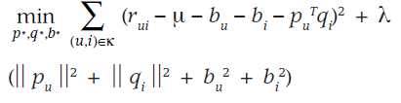
Adding Biases
Extend Eq. 1. :
(4)
System learns by minimizing the squared error function:
(5)

Slide 19
Additional Input Sources
Back to the cold start problem:
Some users supply very few ratings.
Difficult to deduce their preference.
Incorporate additional sources of information about users:
Using the Implicit feedback

Slide 20



Additional Input Sources
Boolean implicit feedback:
N(u) , the set of items for which user u expressed an implicit preference.
A new set of item factors
User can be characterized by the vector:
,
Normalizing form :

Slide 21



Additional Input Sources
Another information source - user attribute
A(u), the set of attribute corresponds to user u.
e.g. age, gender, income level … etc.
User can also be characterized by the vector:
,
We can integrate all signal sources:
(6)

Slide 22
Temporal Dynamics
So far, presented model is static.
In reality, production popularity and user taste change as new selections emerge.
Can significantly improve accuracy.

Slide 23
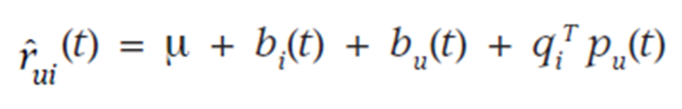
Temporal Dynamics
Decomposing ratings into distinct terms:
Item biases, bi(t):
Item’s popularity might change over time.
User biases, bu(t).
User change their baseline rating over time.
User preference, pu(t)
User change their preference over time.

Slide 24
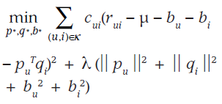
Inputs with Varying Confidence Level
Not all observed ratings deserve the same weight or confidence.
Advertising might influence votes for certain items.
Systems built around implicit feedback.
Model enhance the Eq. 5. to account for confidence:
Collaborative Filtering for Implicit Feedback

Slide 25
Related Extension
PMF – Probabilistic Matrix Factorization
BPMF – Bayesian Probabilistic Matrix
Factorization
GPMF – General Probabilistic Matrix Factorization
BPMFSRIC – Bayesian Probabilistic Matrix
Factorization with Social Relations
and Item contents

